Slide 1
^{INTRODUCTION}
Do we ever think how blind
persons perform his daily
activities which normal people
take for granted????

Slide 2
There are two methods:
Blind Navigation System
Accumulated memories in their long term exploration
The main objective of this Project is to develop a reliable, portable, user friendly and robust solution for smooth navigation at low cost.

Slide 3
TEAM MEMBERS:
Abhishek Sarkar
Electronics and Communication Engineering
Ankita Bhuniya
Electronics and Communication Engineering
Deb Kumar Maity
Mechanical Engineering
Sauryadeep Chowdhury
Mechanical Engineering

Slide 4
Smart Glass for Blind people

Slide 5
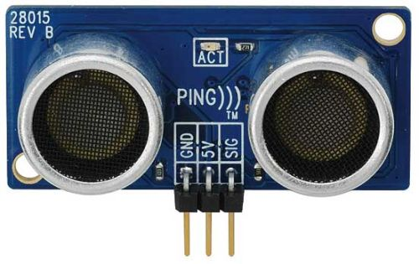
Our Proposal
Five ultrasonic sensors will be installed in the glass to detect the obstacles in the front, left, right and back side respectively.
According to distance, the sensors will detect the obstacles.
A voice alert about the obstacles will be sent to the person through earphone, i.e. guiding the person to choose which direction to move.

Slide 6
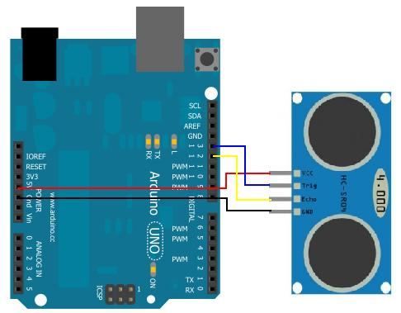
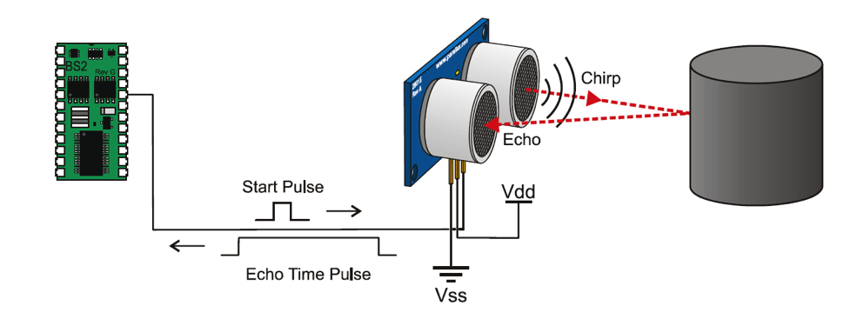
Design of the project
How Ultrasonic sensor works??
Ultrasonic Sensor
Interfacing of sensor with microcontroller(Arduino)

Slide 7
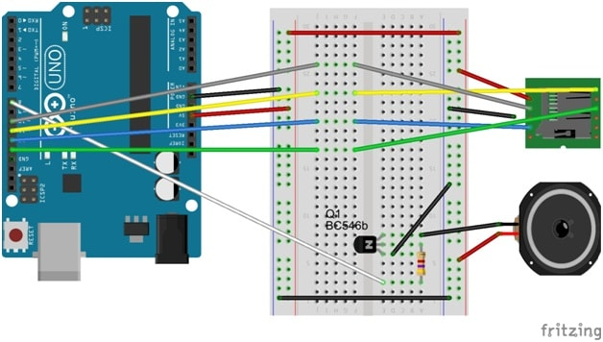
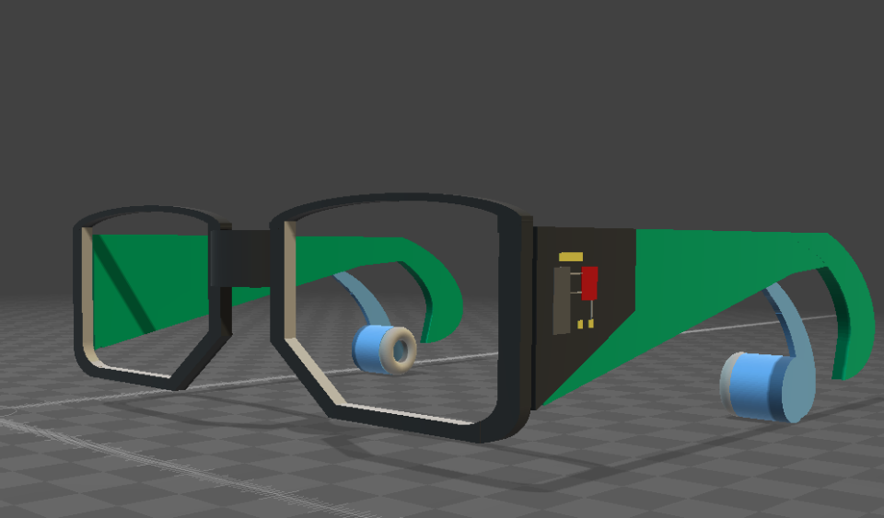
Voice Alert Section
SD Card Module
Voice alert to be given as per the analysis of sensor values. Predefined clips will be stored in the SD card, clips may be segmented to form a total alert for a specific condition.
We are also planning to make this alert to be given via earphone.
8ohm Speaker
A Design of the spectacle with earphone arrangement for voice alert, sensors will be placed at the front, left & right side of it.

Slide 9
Block diagram
Left Sensor
Front Sensor
Earphones
Microcontroller
Back Sensor
Right Sensor

Slide 10
Equipments
ULTRASONIC SENSOR
SD CARD MODULE
EAR PHONE WITH 3.5mm AUDIO MODULE
ARDUINO UNO BOARD with power source

Slide 11
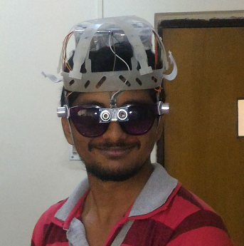
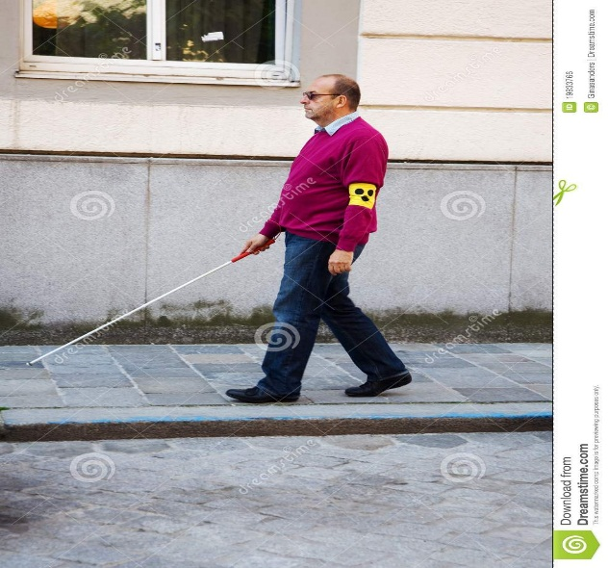
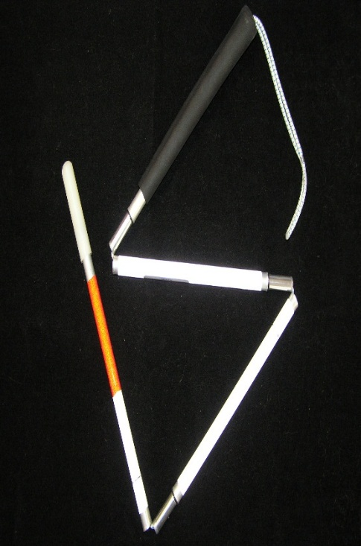
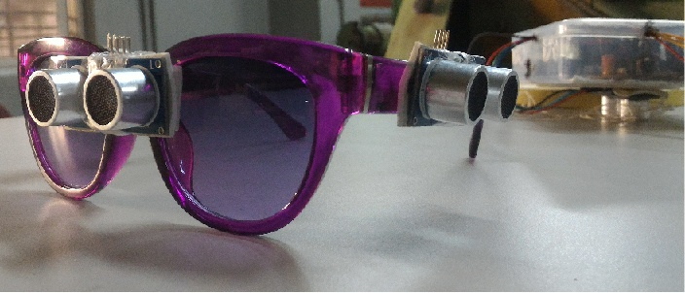
Why our system??? VS

Slide 12
ExistinG solutions
BLIND Man STICK: It cannot detect any obstacle on both left and right side. It normally uses monotonous buzzing alert and not voice based alert.
H.A.L.O( Haptic Assisted Locating of Obstacles): Blind people must sense the motor vibrations to avoid the obstacles,which is not much different than above.

Slide 13
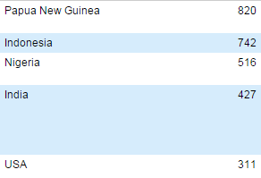
Future plans
GPS assistance.
Multi-lingual System. Language can either be chosen at the time of making an order for our system, or choosing preferred language by using an external additional switch.
Top 5 Nations with maximum number of languages:
Top 10 mostly spoken languages (2014 report) : Chinese, Spanish,
English, Hindi, Arabic, Portuguese, Bengali, Russian, Japanese, Javanese.
We are planning to implement at least 20 languages. For Indians most
importantly for now are English, Hindi, Bengali, Oriya, Assamese, Telegu,
Tamil, Punjabi and some foreign languages like Chinese, French, Japanese,
Spanish, Portuguese, Russian, Arabic, etc.

Slide 14
PRODUCTION
ONE FACTORY IS ENOUGH
INFRASTRUCTURE
TAX
EMPLOYEES
OTHER
ARRANGEMENTS
ASIC BASED DESIGN
total cost
1.5 thousand after implementing future plans
100 more products
30-50k profit

Slide 15
Budget
ITEM NAME | COST(Rs}
ARDUINO UNO BOARD | 450
SENSOR | 525
SD CARD MODULE | 150
3.5mm AUDIO MODULE | 20
SPECTACLE | 350
TOTAL COST | 1495

Slide 16
Conclusion
Our system uses inventive design along with the best of modern technology to ensure Affordability
Ease of operation is of prior concern. It doesn’t use technologies which might be complicated to a blind people
Not the best technology out there but the Best Technology at Affordable cost.

Slide 17
THANK YOU

